Slide 1
Luxury: In the eyes of rebels, the worst aspect of British Colonial America
While we may easily accept and desire luxurious lifestyles and luxury items today, luxury was a highly negative, stigmatizing term used by British colonial American rebels prior to the American revolution to attack everything they saw as wrong about the British empire and its “bad dad,” King George III.
Luxury was gendered feminine: white men who embraced luxurious lifestyles were seen as vicious (meaning vice—not illegal, but highly immoral) and effeminate—NOT HOMOSEXUAL, but negatively stereotyped as feminine.
This attack against men giving into luxury was white men against white men. This gave it further weight as they attacked men for giving up their masculinity to live like women.
Patriot leaders of the revolutionary generation became obsessed over the term luxury, referring to it as “dull animal enjoyment” which left “minds stupified, and bodies enervated, but wallowing forever in one continual puddle of voluptuousness.”
In their minds, white men who embraced luxury gave into sexual wantonness, gambling, drinking, and trying to dress and live like wealthy British aristocrats. Rebels depicted them as lazy and the opposite of hardworking rebels—incapable of freedom and democracy.
British rebels who supported revolution used George III as the primary example of the sin of luxury. He was wealthy and wielded power as the king of England and the exemplar of the British empire. Thomas Paine railed against him as the primary reason that British colonial Americans must separate themselves from the British empire and seek their freedom from divine right monarchs.

Slide 2
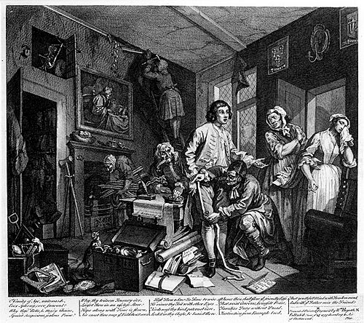
William Hogarth, A Rake’s Progress (1732-1734)
Engraving #1

Slide 3
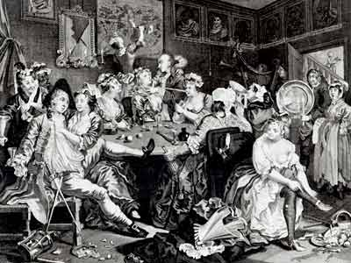
A Rake’s Progress, Engraving #3

Slide 4
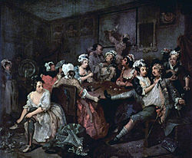
A Rake’s Progress, Number 3

Slide 5
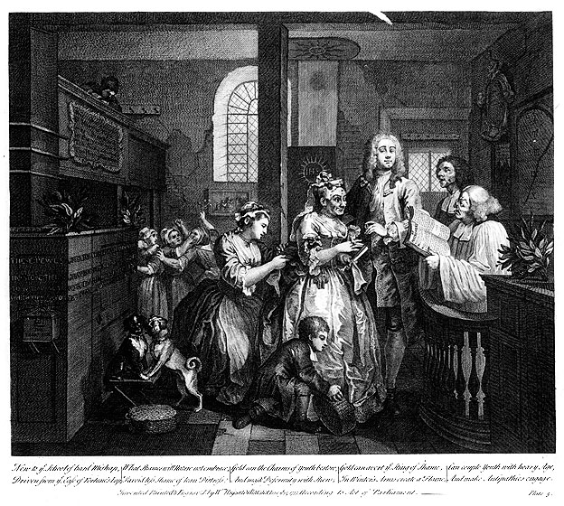
A Rake’s Progress, Engraving #5

Slide 6
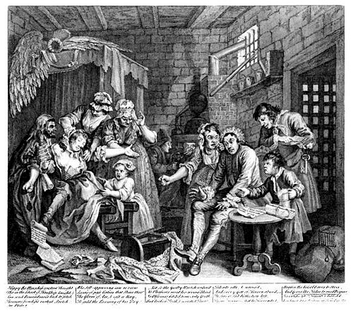
A Rake’s Progress, Engraving #7

Slide 7
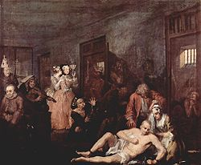
A Rake’s Progress, #8

Slide 8
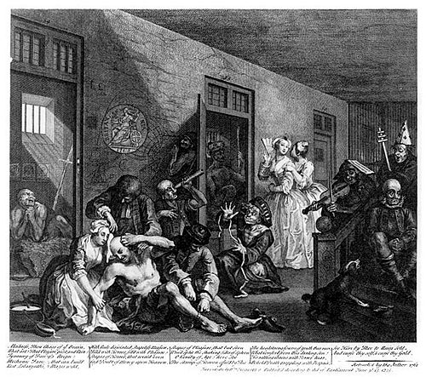
A Rake’s Progress, Engraving #8

Slide 9
Thomas Paine, Common Sense (1776)
“The nearer any government approaches to a Republic, the less business there is for a King. It is somewhat difficult to find a proper name for the government of England. Sir William Meredith calls it a Republic; but in its present state it is unworthy of the name, because the corrupt influence of the Crown, by having all the places in its disposal, hath so effectually swallowed up the power, and eaten out the virtue of the House of Commons . . . [that] it is easy to see that when Republican virtues fails, slavery ensues . . . In England, A King hath little more to do than to make war and give away places; which, in plain terms, is to empoverish the nation and set it together by the ears. A pretty business indeed for a man to be allowed eight hundred thousand [British pound] sterling a year for, and worshipped into the bargain! Of more worth is one honest man to society, and in the sight of God, than all the crowned ruffians that ever lived.

Slide 10
IN CONGRESS, JULY 4, 1776
The unanimous Declaration of the thirteen united States of America
When in the Course of human events it becomes necessary for one people to dissolve the political bands which have connected them with another and to assume among the powers of the earth, the separate and equal station to which the Laws of Nature and of Nature's God entitle them, a decent respect to the opinions of mankind requires that they should declare the causes which impel them to the separation.
We hold these truths to be self-evident, that all men are created equal, that they are endowed by their Creator with certain unalienable Rights, that among these are Life, Liberty and the pursuit of Happiness. — That to secure these rights, Governments are instituted among Men, deriving their just powers from the consent of the governed, — That whenever any Form of Government becomes destructive of these ends, it is the Right of the People to alter or to abolish it, and to institute new Government, laying its foundation on such principles and organizing its powers in such form, as to them shall seem most likely to effect their Safety and Happiness . . . [W]hen a long train of abuses and usurpations, pursuing invariably the same Object evinces a design to reduce them under absolute Despotism, it is their right, it is their duty, to throw off such Government, and to provide new Guards for their future security . . . The history of the present King of Great Britain is a history of repeated injuries and usurpations . . .

Slide 11
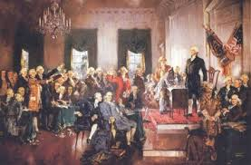
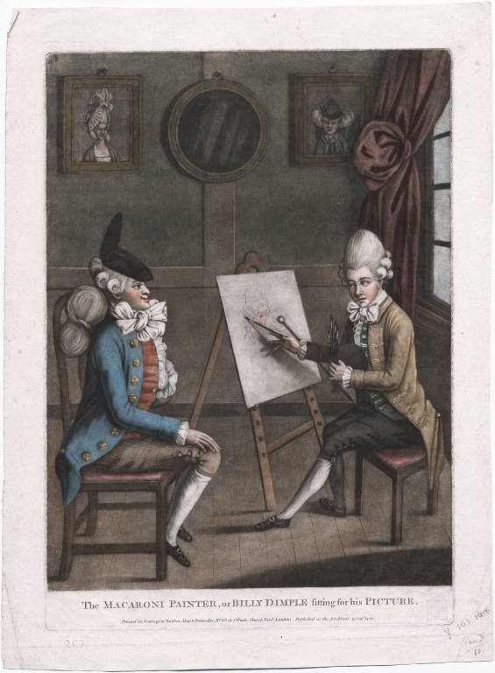
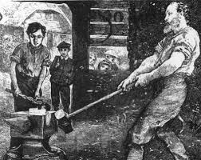
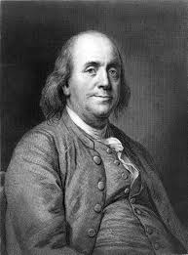
The Contrast, a 1787 comedic play which opened only a few weeks before the Constitutional Convention, posed a crucial question to a brand-new, independent nation: What kind of nation will the United States be? The two leading characters, Billy Dimple (Feminized Fop) and Colonel Henry Manly (Heroic Artisan), were opposites in manhood, morality and virtue. They were both wooing Maria Van Rough, whose father, simply known as Mr. Van Rough (Genteel Patriarch) was another masculine archetype of the time. Out of these three the dominant masculine archetype of the US would emerge: the Self-Made Man.

Slide 12
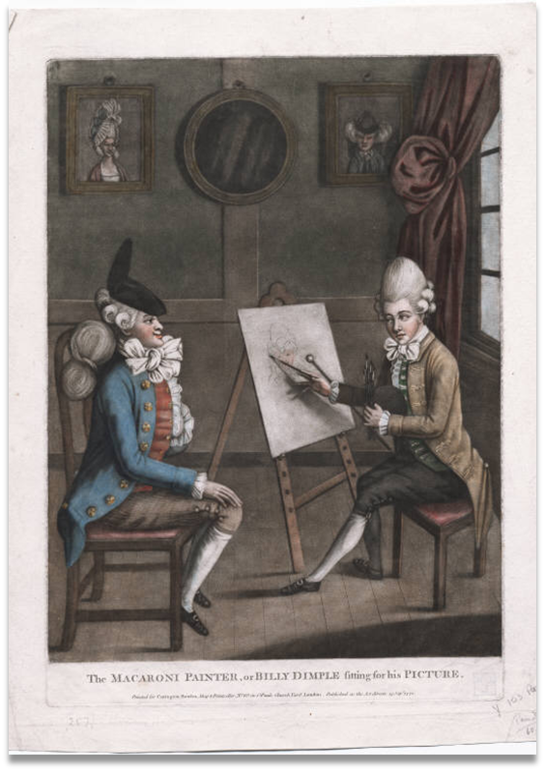
The Feminized Fop: “Billy Dimple”
The Billy Dimple character represents what was seen as the worst of British colonial-era masculinity: effeminate, wealthy, privileged white men bent on luxury.
“Effeminate,” found in the surviving writings of 18th century critics, didn’t mean homosexual. Billy Dimples given to luxury were fully heterosexual: they graded themselves on how well they could seduce and degrade women. But their critics feminized them and their lifestyles due to their dress, their adherence to teas, plays, card games and other frivolous feminine activities. They were hetero—just not the imagined, British colonial “Manly” men.
Luxury was seen as negative, an attack against how British colonial white men viewed themselves—morally, mentally and physically above the sheltered, feminine, rich British aristocracy and its immoral leader, King George III.
In the 19th century, the Feminized Fop lost its flamboyancy, gradually morphing into the “best” of what lingered of the Genteel Patriarch: kind, educated, upper-crust.

Slide 13

The Heroic Artisan: “Colonel Manly”
The British colonial masculine archetype, as portrayed by the character of Colonel Manly, is part of how colonial white men who backed revolution—who agreed that George III, the aristocracy and Parliament were immoral, given to luxury and unworthy of governing the colonies—saw themselves. Physically and mentally strong, independent; “stiff” in his interactions with women (not “soft” and feminine like Dimple; not “fatherly,” upper-class and slightly aristocratic like the Genteel Patriarch); unafraid of hard, manual labor in his own shop; loyal to male friends—especially those who would risk their lives and fortunes for freedom and liberty.

Slide 14
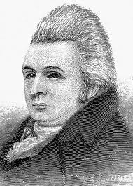
The Self-Made Man: “Mr. Van Rough”
Self-Made Men—the businessmen of the British colonial era or, like the Mr. Van Rough character himself, a wealthy entrepreneur—were the up-and-coming leaders of colonial society.
Self-Made Men had the attribute of independence, like Colonel Manly. But in making money—and they were all about making money—not inheriting money, like the British aristocracy, but actively becoming wealthy through their own efforts—they could claim total responsibility for their wealth. They were public figures, given to a bit of service (not as much as Genteel Patriarchs).
KEY: OVER TIME, the SELF-MADE MAN became the racialized, classed, masculine model for US manhood: independent, defined by boot-strappism, and acquisitive.

Slide 15
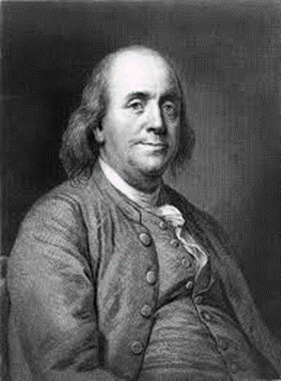
The Genteel Patriarch: Ben Franklin
We have been taught that Founding Fathers—the Benjamin Franklins, George Washingtons, Thomas Jeffersons and the like—are the foundational to how Americans define themselves and their nation.
Genteel Patriarchs were fatherly: educated, public servants, made to be listened to and obeyed; having exquisite tastes; supporting property ownership (access to voting and public office depended strictly on owning property, having the independence of not working for someone else); being Christian—or at least outwardly adhering to tenets of “Christianity”; benevolence.

Slide 16
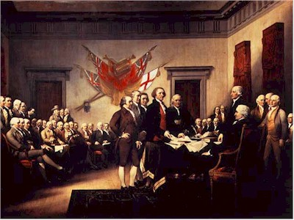
Signing the Declaration of Independence

Slide 17
The Problem with LUXURY: LIKE GREED, IT NEVER WENT AWAY
IN THE ERA OF THE AMERICAN REVOLUTION (1775-1783) YOU CAN SEE MORE WRITERS EXPRESSING A DEEP love of virtue and mortality AND AN EQUAL hatred FOR vice and corruption THAT AT ANY OTHER TIME IN UNITED STATES HISTORY. LUXURY WAS THE RESULT OF VICE AND CORRUPTION, and the OPPOSITE OF VIRTUE AND MORALITYT.
Yet the reason behind this AMAZING love OF virtue and morality and HATRED OF vice and corruption wasn’t just because people were ONLY seeing it in KING GEORGE III and the LEADERS of the British Empire. Some looked around them and feared the immorality, vice and corruption that they saw on a daily basis in British colonial America—EVEN AS THE REVOLUTIONARY WAR ROLLED ON. They began wondering whether fighting AND WINNING a dangerous war against the most powerful empire on the face of the earth would actually create something new: a republic embodied by virtuous, moral citizens, and not MERELY a replication of the immorality, vice and corruption that they WERE FIGHTING TO SEPARATE FROM
Vice was something that many American MALE PATRIOTS the revolution, like their Puritan forefathers, were able to identify without difficulty. vice occurred when a man let his body and mind be dominated by what John Adams called “[the] vicious and luxurious and effeminate Appetites, Passions and Habits.” When Adams said “effeminate, he wasn’t meaning homosexual. He was giving-into the negative gendering of women as inferiors: men who gave into luxurious lifestyles were behaving like women. AND HE WAS TALKING ABOUT HIS WHITE MALE PEERS, SO RACE ALSO ENTERED INTO THIS CONSTRUCTION OF VICE AS THE OPPOSITE OF WHAT MEN SHOULD BE IN A NEW REPUBLIC.
KEY: MOST British colonial American men who backed revolution saw themselves as white men oppressed by other white men WHO WERE 3000 Miles Away, overseeing an empire. They were unwilling to relinquish the notion that they themselves were oppressors, even ruling over heir own white wives and daughters. Giving equal rights across the board to women, particularly married women who lost their identities under coverture, was no more in their minds than the total abolition of slavery.

Slide 18
WHAT KING GEORGE III REPRESENTED:
According to Thomas Paine, George III held the “ ‘pretended title’ of FATHER OF HIS PEOPLE.”
Basically, revolutionaries believed that George was a lousy parent—a “bad dad.” He was wealthy because he was born into the monarchy. He didn’t work and got paid for doing nothing. This wasn’t how virtuous, white British colonial American men lived, not in their own minds and certainly not in the minds of revolutionaries.
Furthermore, in the minds of revolutionaries George III was immoral because he was a monarch; he had given up resisting against luxury because he had accepted his place as the king of England and ruler of the British Empire. Therefore, he was a lousy role model.
When George III had moved some of the concentrated powers that had been held in the House of Commons (representatives of the common folk) over to the House of Lords (the powerful, wealthy aristocrats), revolutionaries argued that George had threatened the safety of his children by failing to protect them. Yet another good reason for separating themselves from the British empire through revolution.

Slide 19
KEY: This smart, rhetorical action of attacking George III as an immoral father of his empire made him less than a brute or savage. “Brute” and “savage” were terms that British colonial whites usually reserved for Africans, African Americans and Native Americans. Their logic followed in this manner: at least brutes or savages didn’t eat their young by living off their hard work and revenue through taxation. Brutes and savages didn’t make war on their families, since all free persons in the British American colonies were a kind of “family” with King George III as their head.
Therefore, after the American revolution began, since Britain was ready to go to war against its rebelling colonists, George III was eating his young in reality—and thus worse than Africans, African Americans or Native Americans. This new rhetoric meant that patriot leaders were justified in their desire to create a new government without a king. Simply reforming Parliament—a monumental task within itself—wouldn’t work. They needed something completely new and different—with no king.

Slide 20
PROBLEM: Other masculine models had proven incapable of instilling virtue in men.
CHURCHES:
Men were still dealing with hierarchies!
GOVERNMENT:
GEORGE III was the Bad Dad
The most powerful church was the Church of England—and the monarch George III was king and ruler of the church of England!
Most British colonial American churches operated in a top-down fashion, with power emanating from bishops-downward.
Protestant denominations dealt with hierarchies of male power as well, extending down to individual homes were men (fathers, husbands) were thought spiritually responsible for their wives, children, servants and slaves.
From the monarchy-downward, the prevalent masculinity model had instilled luxury and the craving for vice instead.
That vice and lack of virtue had crept into the minds of white British colonial American men, from the ruling elite downward: governors and their staffs, the military, the shopowners.
Whether governments or churches, in the minds of revolutionaries, the male-to-male model of power and domination had failed to instill virtue into men. Something had to change!

Slide 21
ENTER “republican motherhood”
“republican motherhood” was an early national (1790-s-1820s) ideology that refered to a shift in thought that historians have seen as white men in the post-American Revolutionary era went from attacking the immorality and lack of virtuous living they saw in the men around them for increasingly assigning significance to the important duties that white women had performed during the American Revolution, and were now shouldering as mothers of the republic in the new United States of America.
KEY: In the early republic, the ideology of republican motherhood reworked the separation of the family and the state by making white women’s familial duties have larger, little “p” political emphasis.
BOTTOM LINE: Motherhood became more important, seen as a hopeful way of teaching boys to become the virtuous men necessary for a new republic.

Slide 22
Why did raising up civic-minded, moral, virtuous white male citizens become a little “p” political responsibility or job for white women? REMEMBER: THE UNITED STATES IS A RACIALLY GENDERED NATION, where issues of race and gender have influenced how policies, politics and live have been worked out since the beginning.
1. White men who contemplated revolting against the British Empire to achieve freedom and liberty, and to separate themselves from the deadly monarchial luxury that they had attacked George III for exhibiting had also spent decades watching other white men fail at teaching one another how to be more moral and virtuous.
2. In the process, they separated their masculinity and identity from men of color and women: most saw themselves as superior to both and yet defined the worst that they saw in themselves as the weaknesses held by men of color and women.
3. Over time, they realized that white mothers might be in a better position than men to carry on this now critically important work of teaching virtue and morality than men. White mothers raised children: they could also teach boys how to become virtuous citizens when they were young, so they could grow into the virtuous men who would lead the nation. White girls were taught the cult of true womanhood: piety, purity, submission, and domesticity. These were considered critical feminine values necessary to build up the new United States and train future generations of boys and girls.
4. This doesn’t mean that white women hadn’t been doing good mothering in the past. It was just that in the surviving writings of revolutionary-era white men, we see that the light bulb finally went on for these men.
4. But don’t get it twisted: when I say little “p” political, I’m referring to one-on-one relationships and informal politics. REGARDLESS OF RACIAL, ECONOMIC OR MARITAL STATE, WOMEN WERE NOT TO BE GIVEN THE RIGHT TO VOTE OR HOLD OFFICE! They were still legally subordinate to men.
5. WHAT WHITE WOMEN DID GET WAS EDUCATION. The importance of mothers as teachers of republican virtues from within the home became a rationale for female education. This rationale became the foundation of K-!2 education, with women seen as perfect educators.

